Slide 1
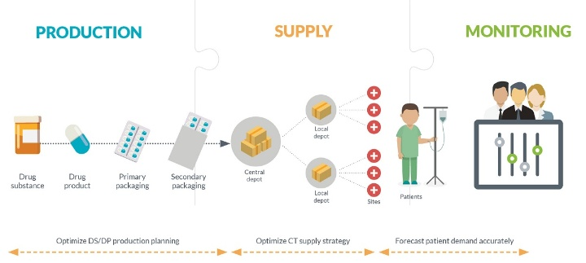
Flow of IP from manufacturing facility to patient and return and documentation required
Aarti,Akshata,Payal

Slide 2

Content
Investigational Product
Key personnel responsible in management of IP
Flow of IP
Documentation
IP related documents
References

Slide 3
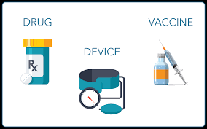
Investigational Product
investigational product. Any pharmaceutical product including a new product, existing product for a new indication, reference product or placebo being tested or used as a reference in a clinical trial.

Slide 4

Key personnel responsible in management of IP
Sponsor
- Manufacturing
- Packaging
- Labeling
- Coding IP
- Storage of IP
CRO
Storage Location
- Temperature log
- Check of essential documents related to IP
- Training to site related to protocol IP

Slide 5

Key personnel responsible in management of IP
Site
Principle investigator
Accountable for receipt, storage, and dispensing of study drug
• Ensure that drug is used in accordance with protocol
Research Coordinator/ Investigational Pharmacist:
• Maintain all documentation related to study drug accountability including all shipping receipts/invoicing as part of the study file
• Initiate the Master Drug Accountability Log
• Dispense study drug
• Monitor temperature for drug supply storage
• Order drug supply for investigator initiated studies
• Instruct subject on proper use and handling of drug

Slide 6
IP Flow
Sponsor manufacturing plant
CRO
Investigator /site
Patient
Used IP
Unused IP
Investigator / Site
Investigator / Site
CRO/Destruction
CRO
Sponsor/Destruction
Sponsor/Destruction
Destruction records
Destruction records

Slide 7

Documentation
Good documentation is an essential part of a quality management system. Documents should be appropriately designed, prepared, reviewed and distributed. They should also be appropriate for their intended use
Documents should be approved, signed and dated by the appropriate responsible persons. No authorized document should be changed without the prior authorization and approval

Slide 8
IP related documents(1/8)
Order
An instruction to process, package and/or ship a certain number of units of an investigational product.
The order should be given by or on behalf of the sponsor to the manufacturer of an investigational product.
Specifications
Specifications for starting materials, primary packaging materials and intermediate and bulk products should be established and approved by a responsible person prior to the use of the lot in clinical studies

Slide 9
IP related documents(2/8)
Product specification file
The Product specification file brings together and contains all of the essential reference documents to ensure that investigational medicinal products are manufactured according to good manufacturing practice for investigational medicinal products and the clinical trial authorization
It should be continually updated as development of the product proceeds, ensuring appropriate traceability to the previous versions.

Slide 10
IP related documents(3/8)
Manufacturing formulae and processing instructions
Every manufacturing operation or supply should have clear written instructions for personnel, based on the relevant product specification file and trial details, and written records to enable the details of activities to be reconstructed
Packaging instructions
The theoretical number of units to be packaged should be specified before the start of the packaging operation
Packaging instructions are based on order and medical product
Investigational products should normally be packed individually for each subject included in the clinical trial

Slide 11
IP related documents(4/8)
Labeling instructions
Investigational products should be labeled in accordance with relevant legislation or best practices.
Batch manufacturing, packaging and testing records
Processing, packaging and testing records should be kept in sufficient detail for the sequence 507 of operations to be accurately traced.

Slide 12

IP related documents(5/8)
Document change control
Manufacturing formula and processing ,packaging and labeling instructions may be changed frequently as a result of new experience, each new version shall be approved by a responsible person, take into account the latest data, and refer to the previous version so that traceability is insured reasons for changes shall be recorded

Slide 13
IP related documents(6/8)
Shipping records for IP
To document shipment dates, batch numbers and method of shipment of investigational product(s) and trial-related materials.
Allows tracking of product batch, review of shipping conditions, and accountability
Certificate of analysis of IP
To document identity, purity, and strength of investigational product(s) to be used in the trial

Slide 14
IP related documents(7/8)
Instruction for handling of IP
To document instructions needed to ensure proper storage, packaging, dispensing and disposition of investigational products and trial-related materials
Shipping records for IP
To document shipment dates, batch numbers and method of shipment of investigational product(s) and trial-related materials
Allows tracking of product batch, review of shipping conditions, and accountability

Slide 15
IP related documents(8/8)
IP accountability at site
To document that the investigational product(s) have been used according to the protocol
To documents the final accounting of investigational product(s) received at the site, dispensed to subjects, returned by the subjects, and returned to sponsor
Documentation of IP destruction
To document destruction of unused investigational products by sponsor or at site

Slide 16

References
ICH-GCP guidelines E6(R2)
WHO GMP
GMP-sop

Slide 17

Thank You

